Slide 1
Taxation Nation: Navigating the Bureaucracy
Adam J. Kantrovich, Ph.D.
Extension Associate Professor of Agribusiness
Director of Income Tax School
Clemson University Extension

Slide 2
Talking Points
Brief Reminders of Tax Considerations:
2017 TCJA
Depreciation
QBI
Farm Syndicate
Trade
Past, Present & Future
What is a Tariff? AND Who pays for it?
What markets have we lost? Can we get them back?
Market Facilitation Program (MFP)

Slide 3
Taxes
Reminders and Considerations

Slide 4
THIS IS NOT TAX ADVICE
Make sure you work with your tax professionals on the specifics.
The information found in this presentation is just a summary and there may be a great deal more specifics and criteria to provide a clear picture of either the piece of legislation or IRS guidance.
This information is for you to be aware that there are changes in some of these areas and to ask the right questions of your tax professional.
There will be further guidance offered in the future by the IRS to provide additional details about some of the comments found within this presentation.

Slide 5
Depreciation Talking Points & Reminders
5-year or 7-year
Section 179 limitations
Special “bonus” depreciation
Trade-in’s

Slide 6
Depreciation – 5 and 7-Year (GDS)
Useful Tax life has changed
5-years on new equipment and machinery
Except for Grain Bins, Fencing, Ginning Equipment, and Land Improvements)
7-years for used (same as previous to 2017 TCJA)
Farms are no longer required to use 150 declining balance for 3,5,7, and 10-year items

Slide 7
Depreciation – Section 179 and Bonus
Section 179
Sec. 179 decision is made on an asset by asset basis vs. by class
$1 million limit indexed for inflation (2019: $1,020,000)
Dollar for dollar phase out at $2.5 million (2019: $2,550,000)
SUV and Truck Limitation
Sec. 179 and SUV’s: Max Sec. 179 amount is $25,000
Pick-up Truck definition:
Cargo area of at least 6 feet of interior bed length (if less than 6’, it is considered an SUV).

Slide 8
Depreciation – Bonus
Special (Bonus) Depreciation
If chosen it is applied to all assets within a given recovery class placed in service in that year
May opt out of 100% and choose 50% for purchases in 2017 and brought into service in 2018.
100% or 50% may be claimed in certain circumstances
May be able to be used on fruit & nuts trees and vines
Will be phased out over time: 2023 at 80%, 2024 at 60%...2026 at 20%, and 0% in 2027
Fruit & Nut Trees and Vines (Special Rules (I.R.C. § 168(k)(5) for fruit trees and vines that have pre-productive period of more than two years.)
Claim bonus depreciation by making an ELECTION (instead of electing out) to do so at time of grafting/planting. The planting is then not eligible for bonus depreciation when placed into service.
Bonus Depreciation may be used even if a farm is required to use the Alternative Depreciation System ADS through I.R.C. § 168(k)(5).

Slide 9
Uniform Capitalization Rules (UNICAP)
This is important for those with fruit and nut trees and vines
Any farm that has an average gross receipts for the past 3-years of $25 million or less (and is not a tax shelter) is not subject to the UNICAP
What happens to those farms that have already opted out of UNICAP?
IRS has not offered guidance on this
Some believe that this is not an issue as they state this is a fundamental rule change that would make those that previously opted out to opt back in allowing for GDS vs. ADS depreciation, bonus depreciation, etc. as long as you meet the exemption rule(s). Which is correct? WE DON’T KNOW!

Slide 10
Trade-In of Equipment and Machinery
PRE-2018 (Trade-ins received Section 1031 deferral)
In the past the trade-in value of an asset was subtracted from the purchase value and the “cash to boot” is what would be depreciated out with no “depreciation Recapture” having to be paid on the asset traded-in. The “cash-to-boot” is the value to be depreciated
2018 and on
Depreciated assets that are traded-in will have a 1245 gain “Depreciation Recapture” paid. It is treated like a sale of an asset
The total value of the purchased asset is what gets depreciated

Slide 11
Trade-In Case Example
Farmer has $100,000 tractor that has been depreciated to $0.
The tractor has a trade-in value of $35,000
Farmer trades-in the used tractor for a new tractor with a sale price of $150,000
Farmer must pay 1245 depreciation recapture (gain) on $35,000
The Farmer will get to Depreciate the selling price of the new tractor of $150,000
Be careful of using Section 179 and Special Depreciation to push your income too low!
You want to be able to maximize benefits of Self-Employed Health Insurance Deduction, Retirement tax benefits, etc.

Slide 12
Qualified Business Income Deduction Section 199A

Slide 13
Qualified Business Income Deduction Section 199A
2017 Tax Cuts and Jobs Act (TCJA)
I.R.C. § 199A (Pub. L. No. 115-97.
Section 199A(a)
Creates Qualified Business Income (QBI) Deduction
For: Individuals, estates, trusts
May be able to deduct up to 20% of QBI from sole proprietorships and pass through entities, real estate investment trusts (REIT) dividends and publicly traded partnership (PTP) income
C-corporations DO NOT qualify for QBI 20% Deduction
I.R.C. § 1382(b) & (c) Are for special rules for Cooperatives
I.R.C. § 199A(b)(7) and 199A(g) special rules for cooperatives and their patrons
There are numerous limitations so you must be CAREFUL!

Slide 14
Qualified Business Income Deduction Section 199a
What is an Specific Service Trade or Business (SSTB)?
If your reputation is based on your skill set i.e. Medical field and Veterinarians, lawyers, accounting, consulting, brokerages, trading, etc. There are always caveats to this.
Generally SSTB are not eligible for the 20% deduction HOWEVER,
No worries if:
SSTB is less than 10% of overall income for business with an avg. of $25 million or less.
SSTB is less than 5% of overall income for business with an avg. of $25 million or more.
If you are above the threshold (MFJ $315,000 taxable income + Phase in amount of $100,000 MFJ) this could be a problem. None of that income is eligible for the 20% QBI deduction

Slide 15
Qualified Business Income Deduction Sec. 199a Limitations
Threshold Phase-out: $157,500 (S) and $315,000 (MFJ) + Phase In of $50,000 (S), $100,000 (MFJ)
If Below Threshold & Does NOT Sell to a Coop:
Which ever is less: 20% of QBI or 20% of Ordinary Taxable Income
If Below Threshold & Does Sell to a Coop:
Deduction = 20% QBI - the lesser of 9% of QBI related to coop income OR 50% of Wages
If Above Threshold (selling or not selling to a coop):
You must have wages to get any deduction or you will be limited to 2.5% of qualified property
If above Threshold and Phase-in, limits on SSTB income, etc.
Qualified Property: All tangible property held for less than 11-years. All property held longer than 10-years and still being depreciated.
Uses Cost Basis of the Qualified Property
Land is not Included!

Slide 16
Qualified Business Income Deduction Section 199A(a)
To receive 20% deduction the income must be Qualified Business Income (QBI)
Most 1231 gains (long-term gains/losses) are not considered QBI
Raised breeding livestock (cull dairy cows) receives long-term capital gains and is not considered QBI
1231 short term gains for “Depreciation Recapture” are QBI
Rent between entities that have common ownership (more than 50%) will be considered QBI (self-rental) if aggregated into one business for tax purposes
A landlord renting ground and is not materially participating in the trade or business the rent will not be considered QBI
Carryover losses incurred prior to 2018 will not be considered in calculating income for the 20%
C-Corps not eligible for Section 199a

Slide 17
Net Operating Loss (NOL’s)
New limit on business losses (Excess Business Loss)
Required to accumulate all losses on taxes
If greater than $250,000 (S) or $500,000 (MFJ) the excess is not allowed
Excess is carried forward as part of NOL
Can only carry-back two years but can be carried forward indefinitely
Can only offset 80% of income

Slide 18
Estate and Gift Taxes
Estate and Gift Exclusion/Exemption (2018 – 2025)
$5,000,000 (Single) base year w/ increase every year as an inflation adjustment
2017
$5,490,000 for single, $10,980,000 for a married couple
2018 – 2025 Tax Years
Base was doubled with continued annual increases based on inflationary equation
For 2019 Single: $11.4 Million; $22.8 Million MFJ
Portability
Surviving spouse may use the unused portion of the deceased spouse (only if proper tax forms are filed!)
Annual Exclusion for gift tax purposes is $15,000 (2018 & 2019)

Slide 19
Farm Syndicate

Slide 20
Burnett Ranches Case
The 6666 Ranches (“Four Sixes Ranch”) east of Lubbock and the Dixon Creek Ranch, northeast of Amarillo.
Operated by the Burnett family for generations.
The Four Sixes ranch was founded by Captain S. B. Burnett sometime between the fall of the Alamo and the commencement of the Civil War.
Active working livestock ranch for 150+ years.
Ms. Marion, Operations Manager for the Burnett Ranches. Sole owner of the Four Sixes Ranch and half owner individually and through the TLAB Trust of Dixon Creek Ranch.
June of 2008: Chief Counsel of the IRS issued Chief Counsel Advice memorandum (CCA) number 200840042.
Ranch operated as limited partnership owned by three partners including an S Corp that owned more than 35% of the limited partnership.
S Corp was wholly owned by individual who participated in management of the ranch.
Chief Counsel ruled that this constituted a farming syndicate tax shelter since the S Corp was not an individual and that under plain reading of the IRC, only individual ownership is shielded due to active participation in farming.
Modified from “What you need to know about the Farming Syndicate Rule” sponsored by Iowa State University and K Coe, ISOM

Slide 21
Burnett Ranches Case
February 13, 2013, U.S. District Court in Texas ruled against the IRS on substantially the same facts finding that intermediate S corporations can still avail themselves of the “active farming” exception.
2014, the 5thCircuit Court of Appeals in Burnett Ranches, Ltd. V. United States ruled in favor of the defendant and against the IRS.
Burnett Ranches, Ltd. v. U.S. (5thCir. 2014)
“Uninterrupted history with the farming operations and the lands on which they are conducted could be the poster child for Congress’s inclusion of the Active Participation Exception in §464 to exempt such entities and their substantial hands-in-the-dirt owners and operators from that section’s reach.”
“Congress thus expressly provided that any interest in an agricultural venture that is “attributable to” an individual’s “active participation” in the “management” of the farming activity for more than five years is not to be treated as the interest of a proscribed limited partner or limited entrepreneur. Importantly, Congress did not restrict sub-subsection (A)’s particular exception to interests of which such an actively participating manager holds legal title in his or her name.”
Modified from “What you need to know about the Farming Syndicate Rule” sponsored by Iowa State University and K Coe, ISOM

Slide 22
Burnett Ranches Case
January of 2017, the IRS issued an Action on Decision (AOD) letter disagreeing with the interpretation of the 5thCircuit and declaring that, outside of the 5thCircuit, the IRS would disregard the court’s ruling.
In the AOD, the IRS stated that outside of the 5thCircuit “the Service will continue to assert that the §464(c)(2)(A) exception must be read in reference to the statute as a whole, and that the exception applies only to an interest held by the individual meeting the active participation requirement. Thus, the exception does not apply to a limited partnership interest held by a separate legal entity such as an S corporation.”
“We . . . will continue to litigate our position in cases in other circuits.”
Modified from “What you need to know about the Farming Syndicate Rule” sponsored by Iowa State University and K Coe, ISOM

Slide 23
Farm Syndicate - Rule
WHY IS THIS IMPORTANT?
IRC 448(a) General Rule: C Corps, partnerships with C Corp as a partner and tax shelters can’t use the cash method of accounting.
Although farms would normally receive special treatment especially if it has less than $25 million in gross revenue to be able to use the cash method unless it is considered a farming syndicate

Slide 24
Trade and Tariffs
Quid Pro Quo? (Latin Translation: Something for Something)

Slide 25
Tempting Fate?
Trade Wars are a little like securing fuel cans with a lit cigarette going 70 mph down the Interstate.
At some point someone is going to pay for it! But who?

Slide 26
ARE WE IN A TRADE WAR?
Have we instituted tariffs against another country?
Has that country then in retaliation instituted or increased tariffs against us?
YES, we are in a trade war with multiple partners
CHINA – Seems like almost everything
EU – Ag products, manufacturing, etc.
Canada & Mexico, ag, processed products, raw materials
AND Others... Brazil & Argentina (again with steel & Aluminum), South Korea, etc.
Constant issues and threats with many countries have taken place over the past few years and it does not look like it will subside

Slide 27
Why is China so important?
Population: 1.379 Billion (2017 Estimate)
1979 – 2015 1 Child Rule, Oct. 2015 – Present 2 Child Rule
20% is age 55 or older
Middle Class est. at 430 Million, expected to be 780 Million by mid 2020’s
U.S. Comparison: Population just over 330 Million (est. – U.S. Census Population clock. Dec. 2, 2019)
Middle Class est. 49.9%
China’s middle class’ wealth is growing and has an appetite for western products including protein!
Extra tidbit: More people are retiring in China than there are people to replace them
Canada and Mexico play a significant role in our export market(s)

Slide 31
2015/16 - 2017/18 Marketing Yr Ag Production % Exported

Slide 34
Fiscal Year U.S. Export Value – Not looking as good as 2000 - 2018

Slide 35
Fiscal Year – U.S. Exports

Slide 36
Fiscal Year – U.S. Export Volumes
2018
2019

Slide 41
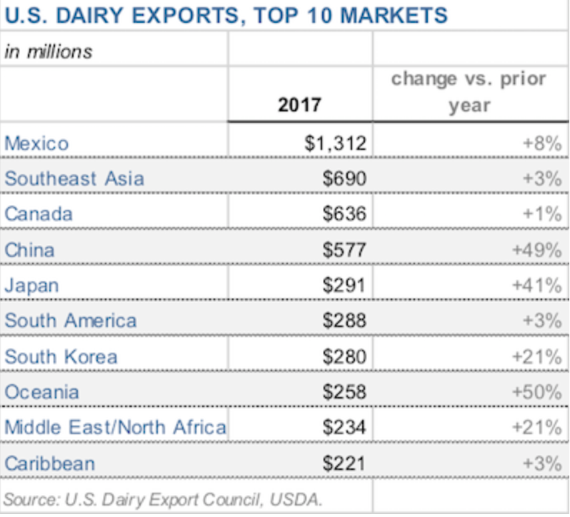

Slide 43
Will We Get Those Markets Back?
It’s Possible!
But very unlikely.
We may get some back but it will be difficult to recover all of it.
Trading partners have found other potential markets and now want to diversify where they make purchases in the future
Not only did we lose the markets we had built but we lost the increase that we would have expected to take place over this time.

Slide 44
What is a Tariff and Who Pays for it?

Slide 45
What is a Tariff?
It is a TAX!
A tax on goods that are imported into the country
SO, in the end who pays the taxes?
WE DO!

Slide 46
Who Pays for it?
The importer first pays the tax on the goods being imported
Some businesses may use a ”third” party such as a broker that represents the business/individual purchasing the imported goods. The third party through the broker will then be responsible for paying the tax
The tax/duty is paid to U.S. Customs and Border Protection Service

Slide 47
Who Pays For it?
Example: A large U.S. national electronics chain imports DVD players from their manufacturer in China, the U.S. store pays the tariff.
The store can ”eat” the cost and make a lower margin of profit AND the share holders of stocks/ or owners will loose out by receiving a lower stock dividend or lower profit
OR the store can pass the additional cost on to the consumer
Which option do you think will be chosen?

Slide 48
What Happens?
Short-Term
May see higher prices on many goods
Leads to reduction in consumption for some of those goods
Long-Term
Decline in competition could lead to less domestic efficiency and eventual increase in costs
Domestic producers may increase their costs to match the costs of the foreign products and or stay just below those costs still increasing the costs to consumers and for other businesses
Good Read: https://www.taxpolicycenter.org/taxvox/what-tariff-and-who-pays-it

Slide 49
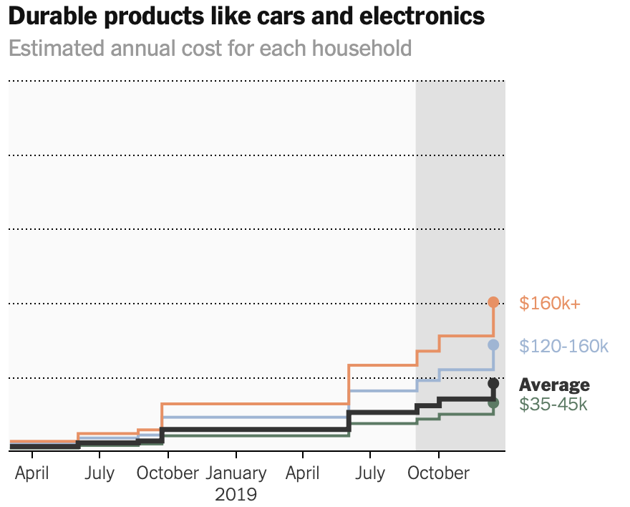
Tariff on Steel and Aluminum
Tariffs placed on Steel and Aluminum
Robert Scott of the Economic Policy Institute: as of late 2018 hundreds of jobs have been created! YEAH!
HOWEVER the U.S. consumer/taxpayer has subsidized these jobs. Estimates range from between $300,000 - $2.3 million per job created.
$600
$400
$200

Slide 50
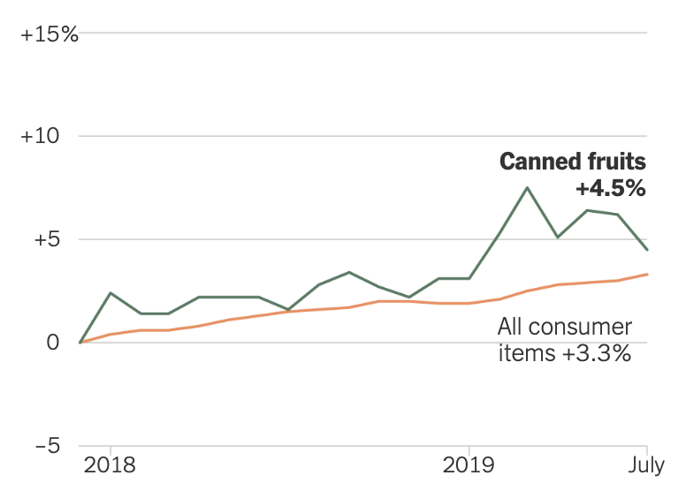
Who is paying for it?
Industries with slim margins typically pass the tariffs on to consumers such as grocery stores and other retail outlets.

Slide 51
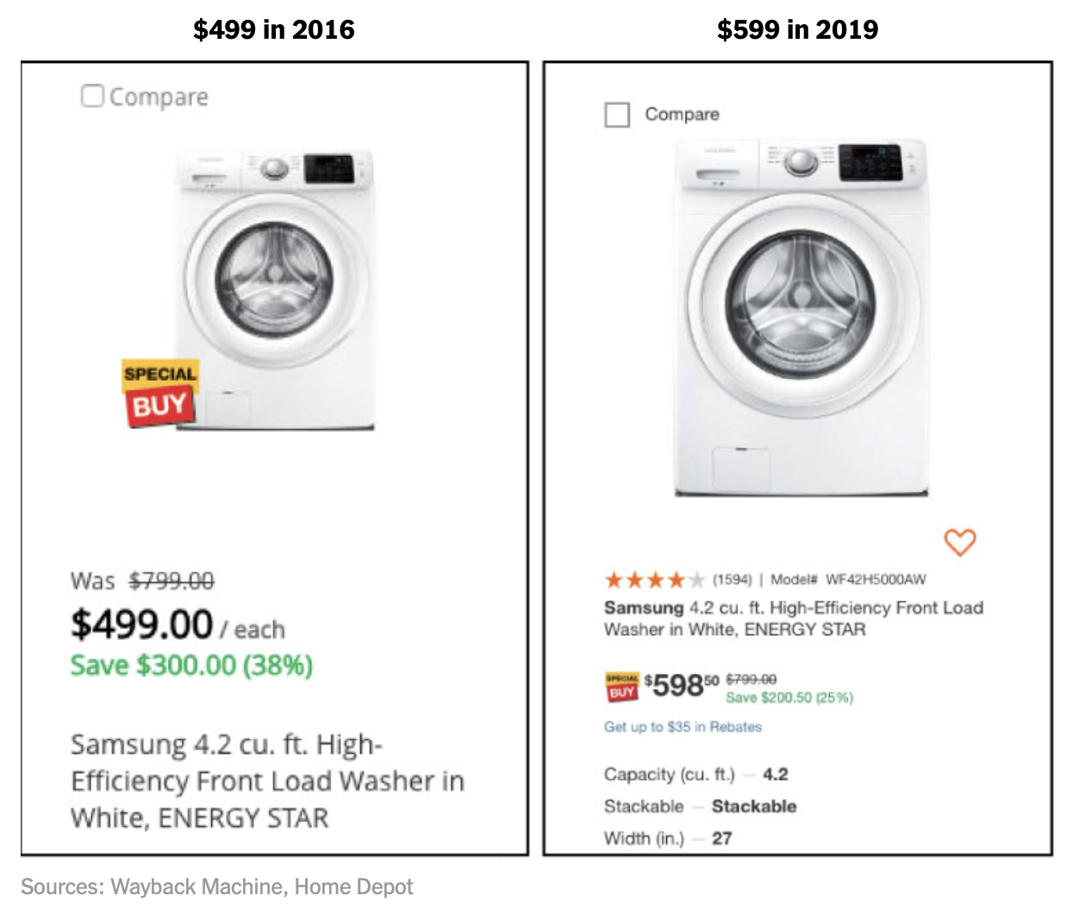
Who’s Paying For It?
Federal Reserve and Univ. of Chicago Researchers found that consumers “bore between 125 and 225 percent of the costs of washing machine tariffs”
How is that possible, they paid more than 100% of the tariff???
WELL, the appliance retailers charged even more than the tariffs had cost them!
$499 in 2016
$599 in 2019

Slide 52
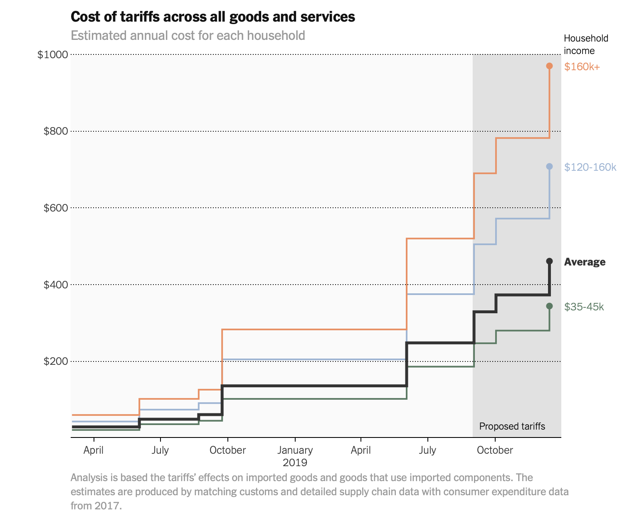
Who’s Paying For It?
Federal Reserve of NY, Princeton Univ. and Columbia Univ. found that domestic consumers felt the brunt of the 2018 tariffs with a ”reduction in U.S. real income of $1.4 billion per month”
Domestic producers of products competing with foreign goods that have a tariff also raise prices, this may boost their profits but the users of those goods are now hurt i.e. automotive industry purchasing steel.
They may reduce their overall purchases, cut jobs, or look at even cheaper market options
The newer round of 15% tariff on Chinese goods would cost the avg. American family about $460 a year according to economists at the University College of London and the London School of Economics

Slide 53
Market Facilitation Program (MFP)

Slide 54
Farm Income
USDA Forecasting a 10% increase in Ag Income (about $8.5 Billion) for 2019 when compared to 2018
Direct Farm Payments from the MFP is expected to be about $22.4 Billion ($8.8 Billion in 2018), 64% increase
This would account for about 24% of all farm income

Slide 55
What is it?
Direct payments to farmers that have been impacted by retaliatory tariffs
Established under the Commodity Credit Corp (CCC)
CCC established to assist during the great depression
CCC is under the USDA – FSA
2nd year of payments ($14.5 billion for 2019)
2019 made in 3 tiers based on determined need. 1st was 50% of possible total and then 25% and 25% if determined still needed
Payments are determined differently than in 2018
USDA: https://www.farmers.gov/manage/mfp

Slide 56
Issues
$$ IF all 3 payments are paid for 2019 crop year it may exceed $24 billion
For some farms in midwestern states this may be as high as 80% of their income
Does it effect potential planting decisions?
Yes, that was a rhetorical question
Sets potential precedent for future payments
Will this become an annually expected income? Should it?
May allow for other established caps to be exceeded when added to other Federal USDA programs
Will this create additional negative views of farm programs when the next Farm Bill is to be developed?
Potential legal issues with the WTO?
What about all of the other industries not receiving payments that have been a/effected by the trade policy?
Good article for further investigation at: https://farmdocdaily.illinois.edu/2019/11/the-market-facilitation-program-a-new-direction-in-public-agricultural-policy.html

Slide 57
What If Farmers Change Their Behavior?
What is the best cure for low prices?
Low Prices! Same is true for high prices.
What other part of the ag industry could be hit if farmers make decisions?
Usually we something similar to corn to soybeans?
But what about grain to edible beans?
Or tobacco to strawberries or tomato’s?
We are already seeing some of this occur due to MFP as well as the trade war.
So what's next?

Slide 58
Summary
Depreciation: Get with your Tax preparer now and plan.
QBI Deduction:
Make sure they run this by hand to get it correct!
Last year much of the tax software was incorrect
Oh heck, just file an Extension you know your going to anyhow
Farm Syndicate: Work with your trusted advisor(s) to see if this effects you and if you need to change
Trade
Lost trust, lost markets,
increased consumer costs, raw material and production costs, and stifled potential growth.
Glimmers of hope? Always
MFP: Could have long-term negative repercussions to future Farm Bills, USDA farm program payments
Market Disruption:
It’s a potential
Fewer Farmers

Slide 59
Contact Information
Adam J. Kantrovich, Ph.D
Extension Associate Professor of Agribusiness & Director of Clemson Income Tax School
Clemson University Extension
Sandhill Research and Education Center
900 Clemson Rd.
Columbia, SC 29229
akantro@clemson.edu
803-778-5700 Office
616-834-8377 Cell
Clemson University Extension AgBusiness Team
http://www.clemson.edu/extension/agribusiness

